Slide 1
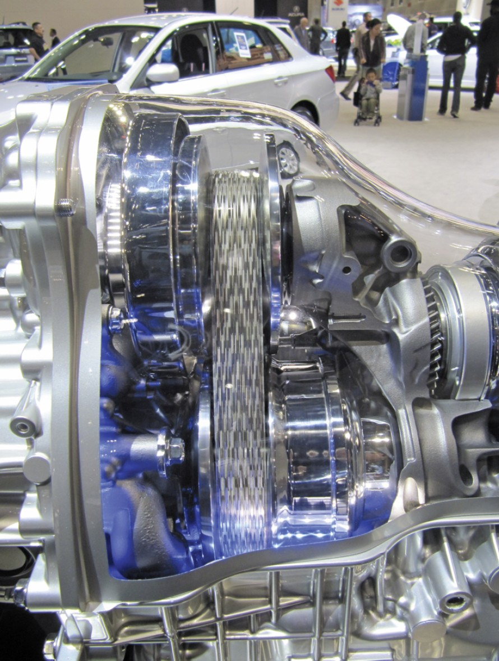
CHAPTER 6 FRICTION
CHAPTER OUTLINE
6/1 Introduction
SECTION A Frictional Phenomena
6/2 Types of Friction
6/3 Dry Friction
SECTION B Applications of Friction in Machines
6/4 Wedges
6/5 Screws
6/6 Journal Bearings
6/7 Thrust Bearings; Disk Friction
6/8 Flexible Belts
6/9 Rolling Resistance
Courtesy of Alyse Gagne

Slide 2
Article 6/1 Introduction
Introduction and Overview

Slide 3
Article 6/2 Types of Friction
Dry Friction
Fluid Friction
Internal Friction

Slide 4
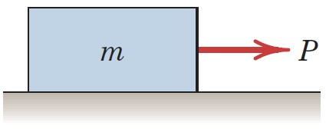
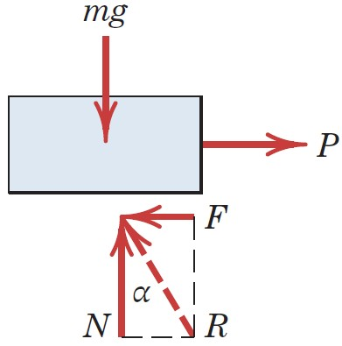
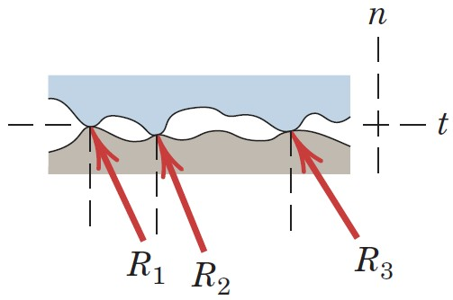
Article 6/3 Dry Friction
Mechanism of Dry Friction
Block on a Rough Surface
Free-Body Diagram
Close-Up of Mating Surfaces

Slide 5
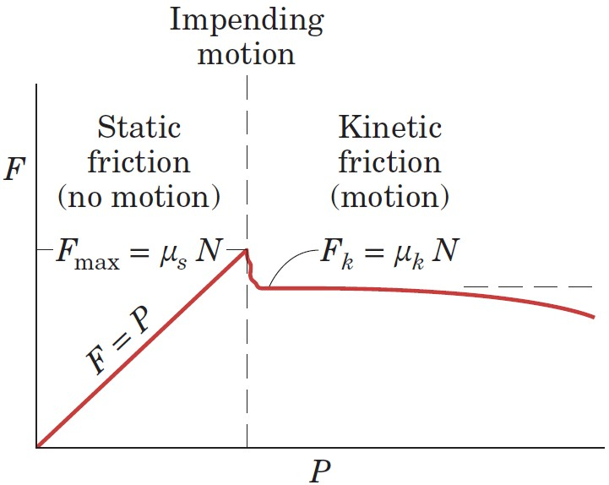
Article 6/3 – Plot of Friction Force
Regions of Significance
Static Friction Range, F < F_{max}
Impending Motion, F = F_{max} = 𝜇_{s}N
Kinetic Friction, F = F_{k} = 𝜇_{k}N

Slide 6
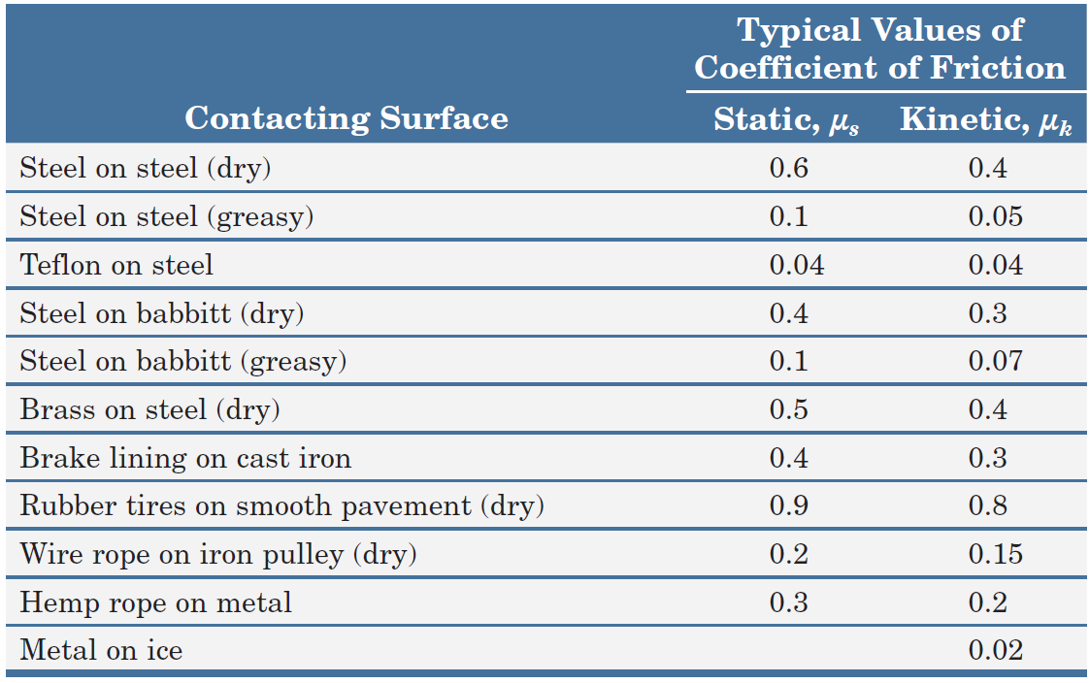
Article 6/3 – Friction Coefficients
Coefficient of Static Friction, 𝜇_{s}
Coefficient of Kinetic Friction, 𝜇_{k}
Table of Values
Exact values for a specific problem can vary
significantly from the values presented.

Slide 7
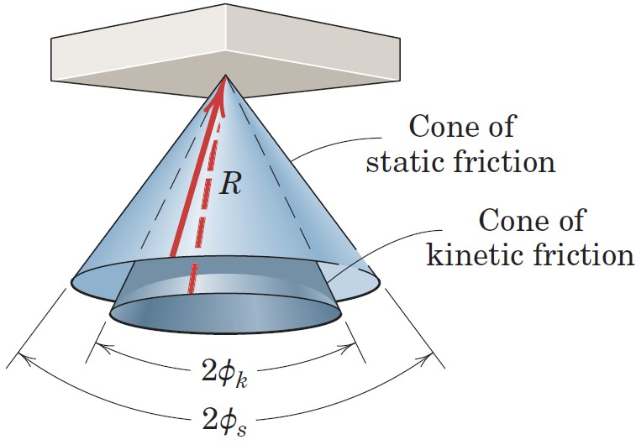
Article 6/3 – Friction Angles
Static Friction Angle, 𝜙_{s}
tan 𝜙_{s} = 𝜇_{s}
Kinetic Friction Angle, 𝜙_{k}
tan 𝜙_{k} = 𝜇_{k}
Friction Cones

Slide 8
Article 6/3 – Factors Affecting Friction
Contact Area
Molecular Attraction
Temperature
Adhesion
Relative Hardness of Mating Areas
Surface Films

Slide 9
Article 6/3 – Types of Friction Problems (1 of 2)
Type I: Impending Motion
Body is on the verge of slipping.
Equilibrium holds for the body.
F = F_{max} = 𝜇_{s}N
Type II: Relative Motion Exists
Body is slipping.
Equilibrium does not hold in the direction of slip.
F = F_{k} = 𝜇_{k}N

Slide 10
Article 6/3 – Types of Friction Problems (2 of 2)
Type III: Unknown – Body may or may not be slipping
Analysis Steps
Assume equilibrium of the body.
Solve for the necessary equilibrium friction force F.
Check the assumption of equilibrium.
If F < (F_{max} = 𝜇_{s}N):
Friction force necessary for equilibrium can be supported, and the body is in static equilibrium as assumed. The actual friction force F is less than the limiting value F_{max}.
If F = (F_{max} = 𝜇_{s}N):
Motion is impending, but the assumption of equilibrium still holds.
If F > (F_{max} = 𝜇_{s}N):
The surfaces cannot support more force than the maximum 𝜇_{s}N, so the assumption of equilibrium is invalid. Motion occurs and F = (F_{k} = 𝜇_{k}N).

Slide 11
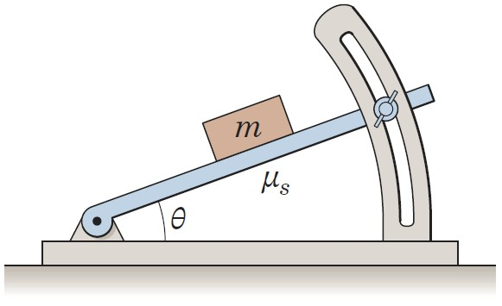
Article 6/3 – Sample Problem 6/1 (1 of 2)
Problem Statement
Determine the maximum angle 𝜃 which the adjustable incline may have with the horizontal before the block of mass m begins to slip. The coefficient of static friction between the block and the inclined surface is 𝜇_{s}.

Slide 12
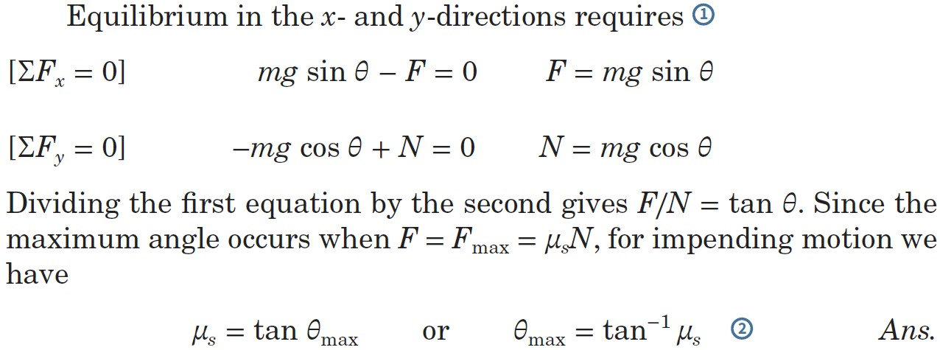
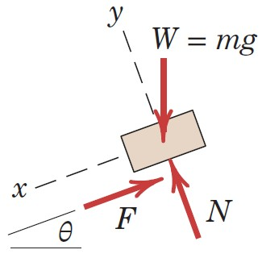
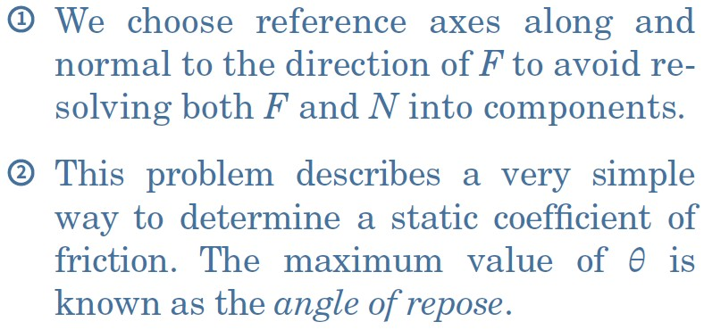
Article 6/3 – Sample Problem 6/1 (2 of 2)
Equilibrium Conditions

Slide 13
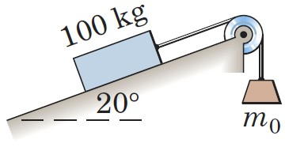
Article 6/3 – Sample Problem 6/2 (1 of 3)
Problem Statement
Determine the range of values which the mass m₀ may have so that the 100-kg block shown in the figure will neither start moving up the plane nor slip down the plane. The coefficient of static friction for the contact surfaces is 0.30.

Slide 14
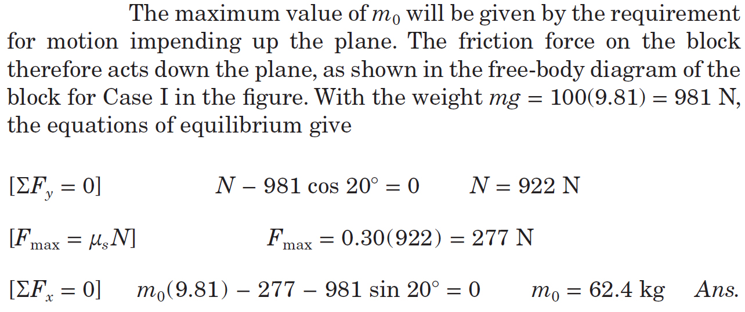
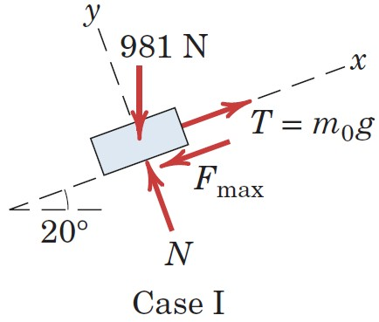
Article 6/3 – Sample Problem 6/2 (2 of 3)
Case I: Motion Impends Up the Plane

Slide 15
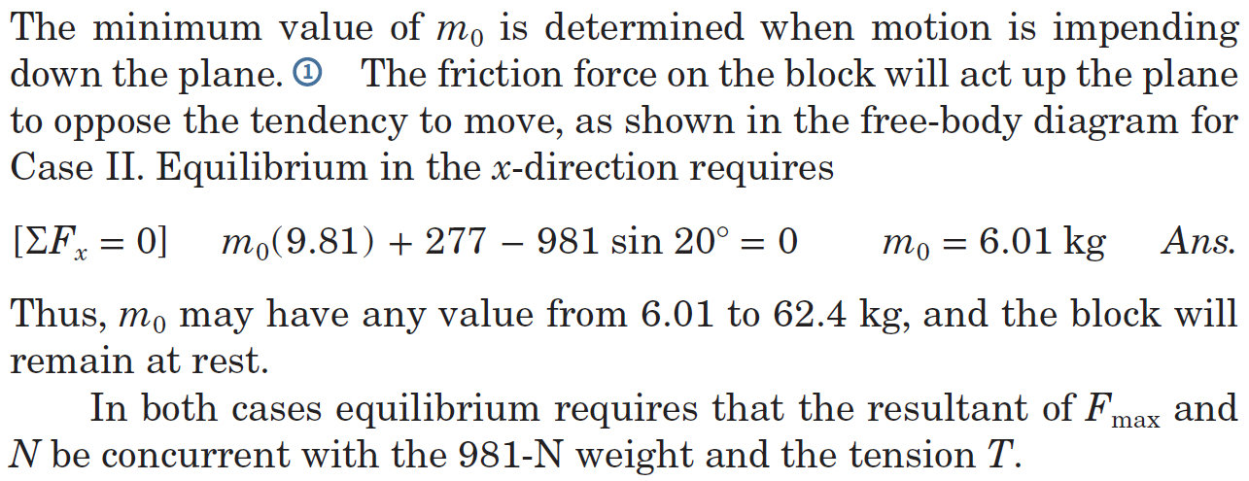
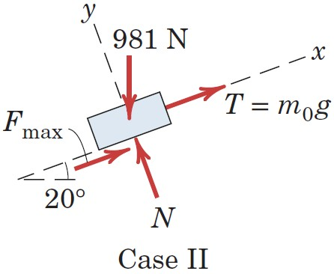
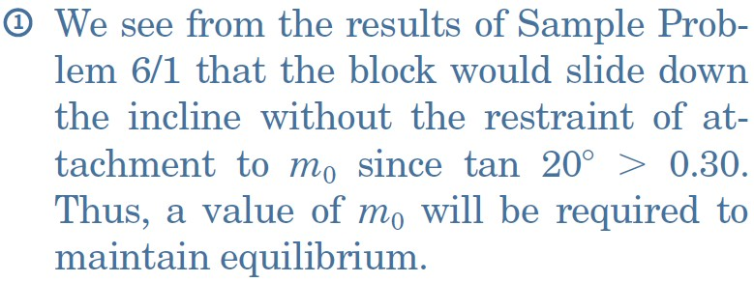
Article 6/3 – Sample Problem 6/2 (3 of 3)
Case II: Motion Impends Down the Plane

Slide 16
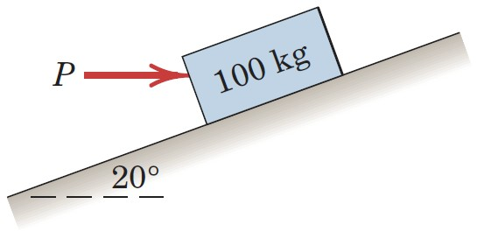
Article 6/3 – Sample Problem 6/3 (1 of 4)
Problem Statement
Determine the magnitude and direction of the friction force acting on the 100-kg block shown if, first, P = 500 N and, second, P = 100 N. The coefficient of static friction is 0.20, and the coefficient of kinetic friction is 0.17. The forces are applied with the block initially at rest.

Slide 17
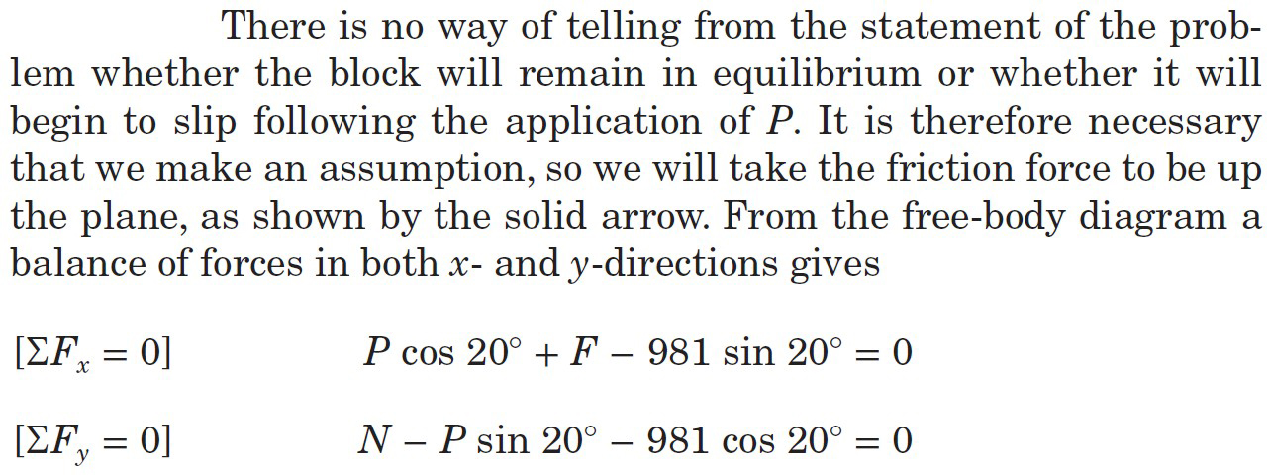
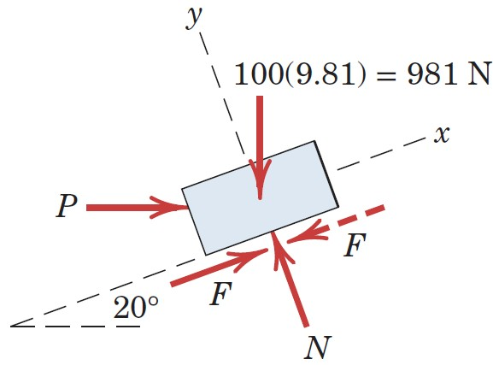
Article 6/3 – Sample Problem 6/3 (2 of 4)
Equilibrium Conditions

Slide 18
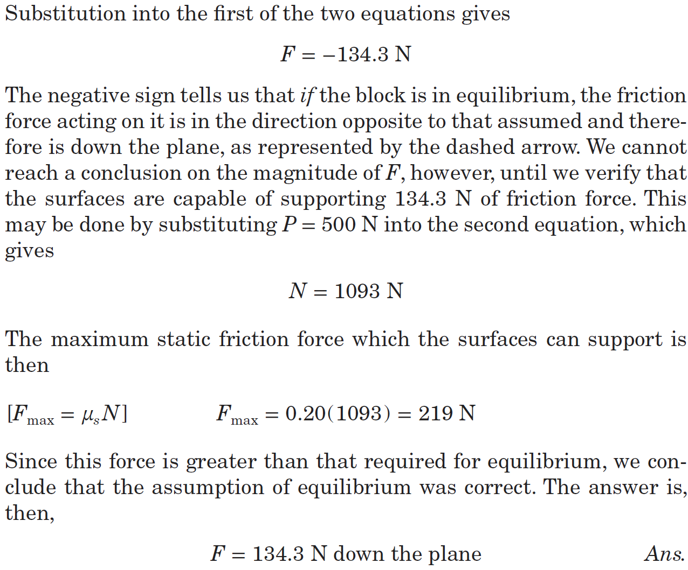
Article 6/3 – Sample Problem 6/3 (3 of 4)
Case I: P = 500 N

Slide 19
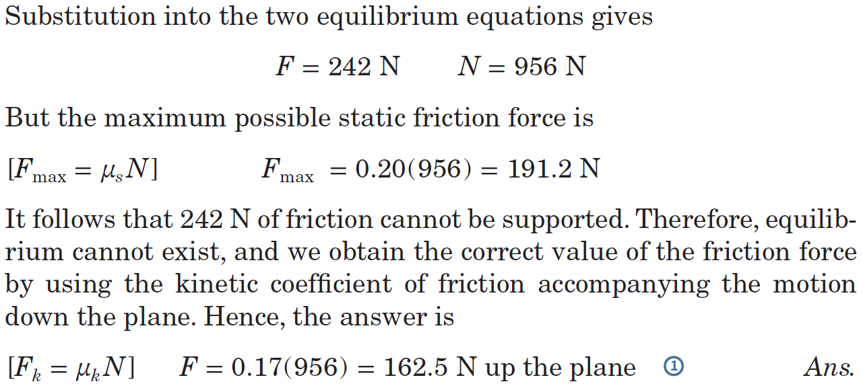
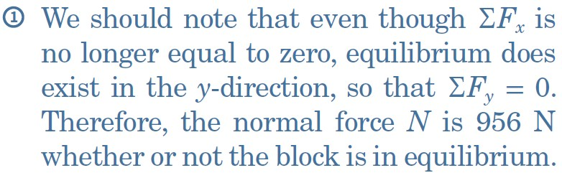
Article 6/3 – Sample Problem 6/3 (4 of 4)
Case II: P = 100 N

Slide 20
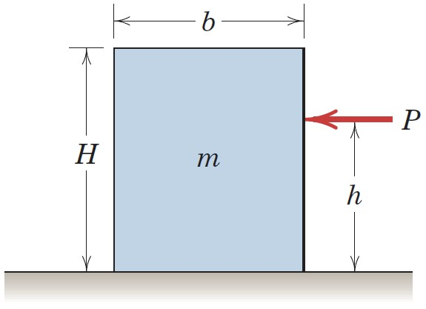
Article 6/3 – Sample Problem 6/4 (1 of 3)
Problem Statement
The homogeneous rectangular block of mass m, width b, and height H is placed on the horizontal surface and subjected to a horizontal force P which moves the block along the surface with a constant velocity. The coefficient of kinetic friction between the block and the surface is 𝜇_{k}. Determine (a) the greatest value which h may have so that the block will slide without tipping over and (b) the location of a point C on the bottom face of the block through which the resultant of the friction and normal forces acts if h = H/2.

Slide 21
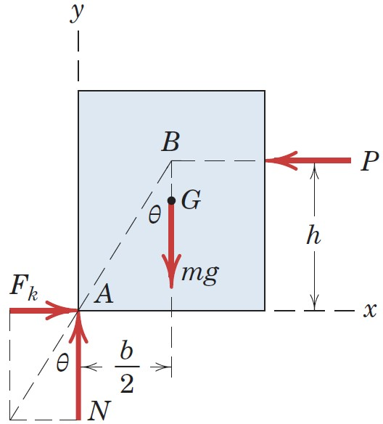
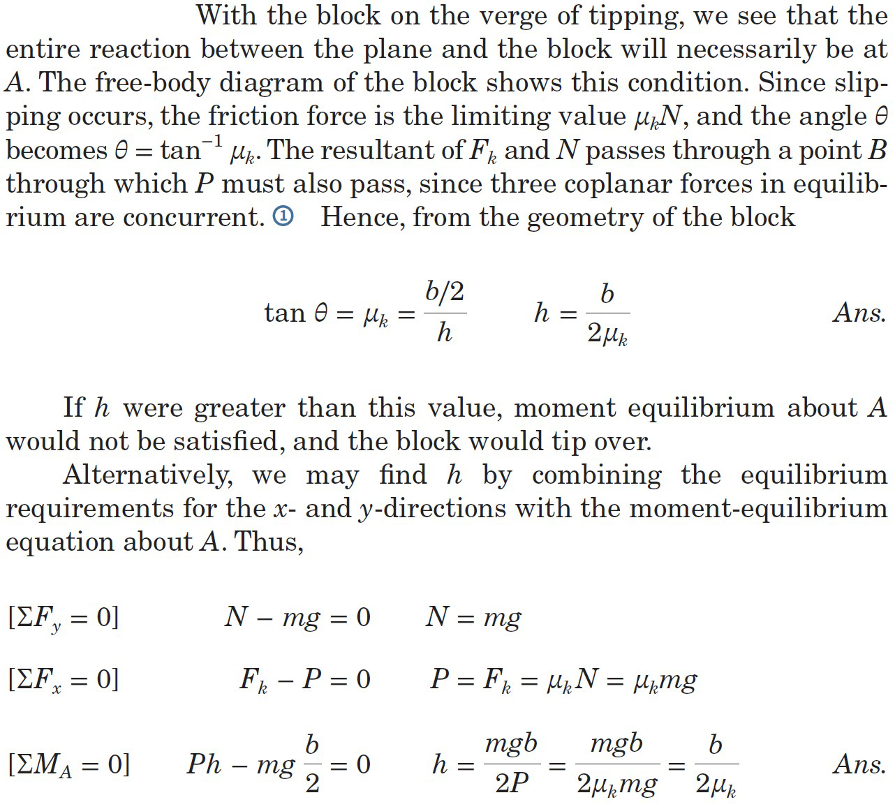
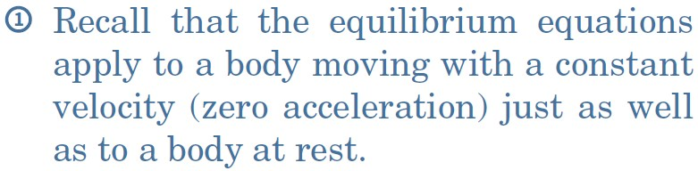
Article 6/3 – Sample Problem 6/4 (2 of 3)
Part (a) Maximum Value of h

Slide 22
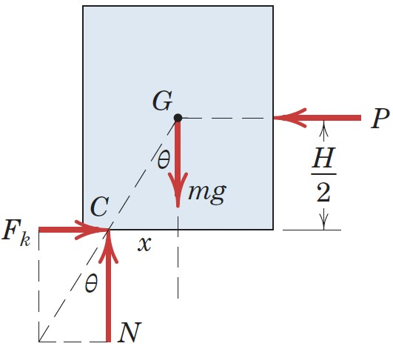
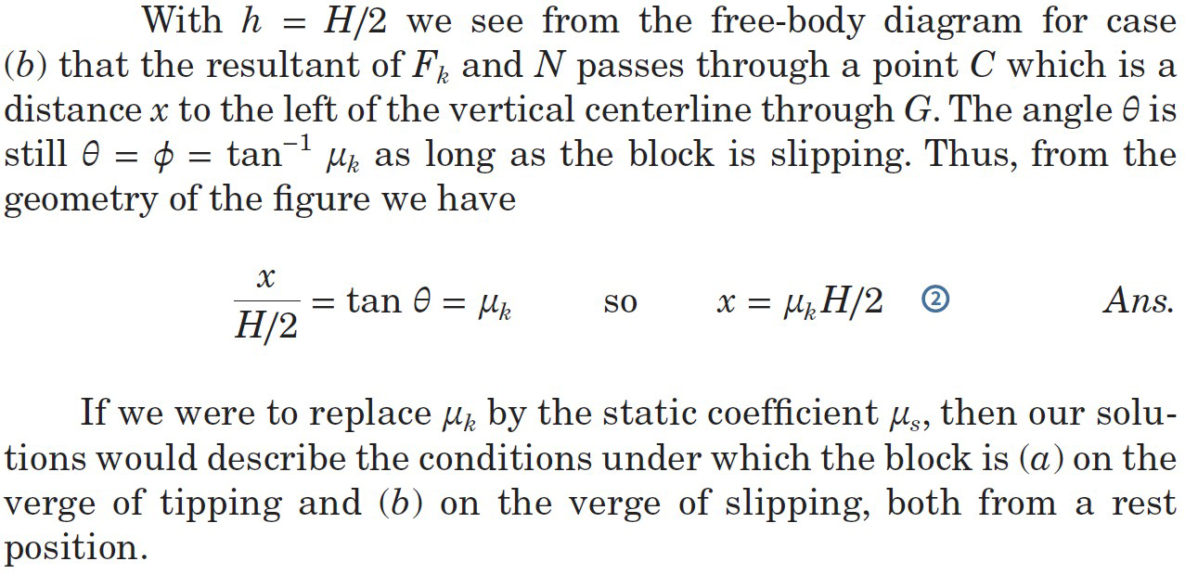
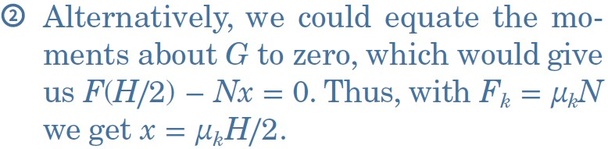
Article 6/3 – Sample Problem 6/4 (3 of 3)
Part (b) h = H/2

Slide 23
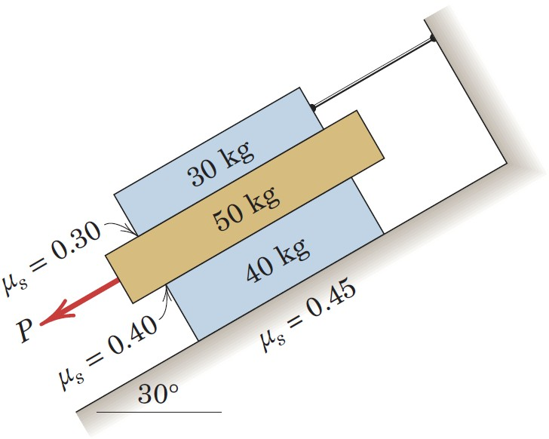
Article 6/3 – Sample Problem 6/5 (1 of 4)
Problem Statement
The three flat blocks are positioned on the 30° incline as shown, and a force P parallel to the incline is applied to the middle block. The upper block is prevented from moving by a wire which attaches it to the fixed support. The coefficient of static friction for each of the three pairs of mating surfaces is shown. Determine the maximum value which P may have before any slipping takes place.

Slide 24
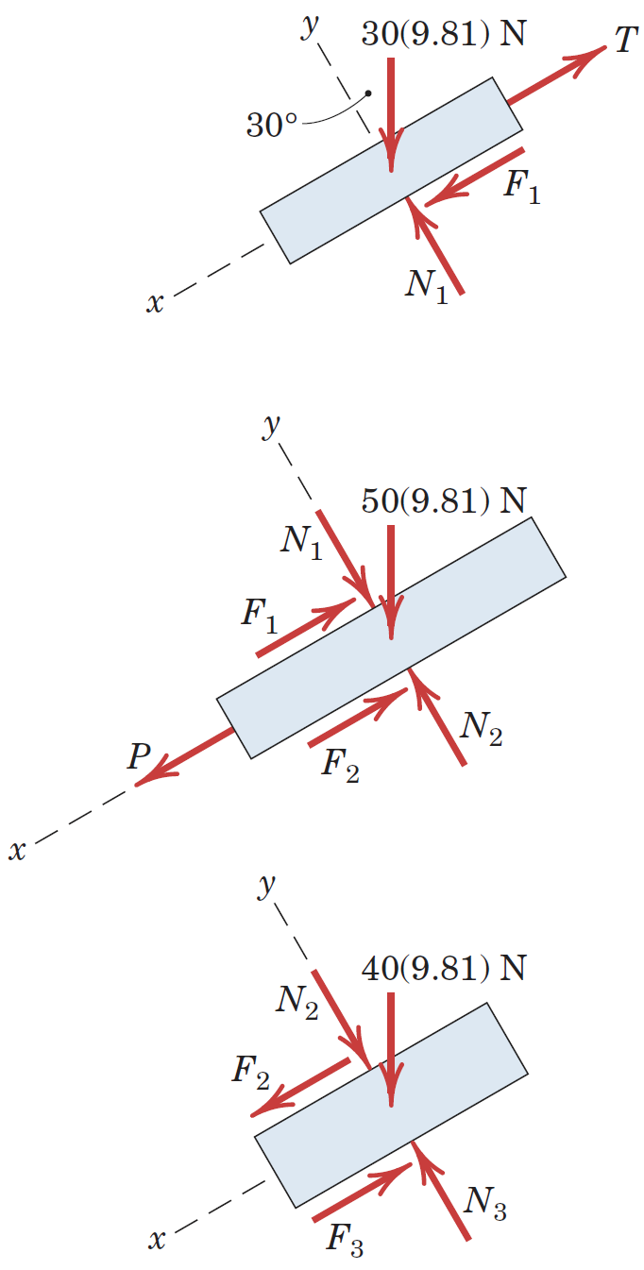
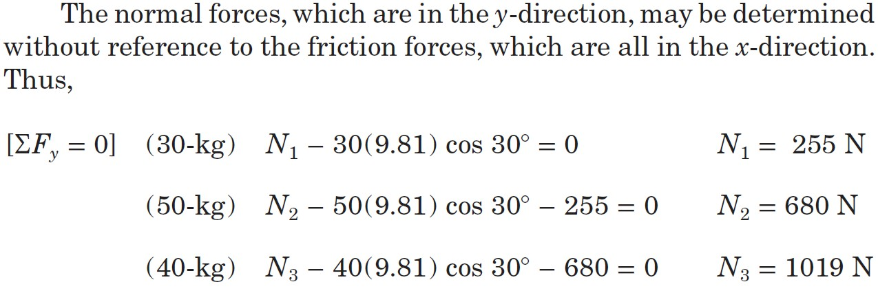
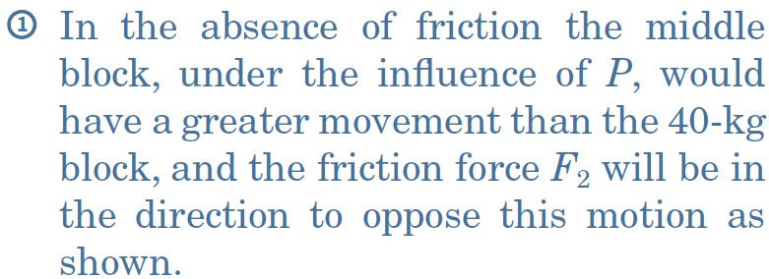
Article 6/3 – Sample Problem 6/5 (2 of 4)
Free-Body Diagrams
Normal Force Calculations

Slide 25
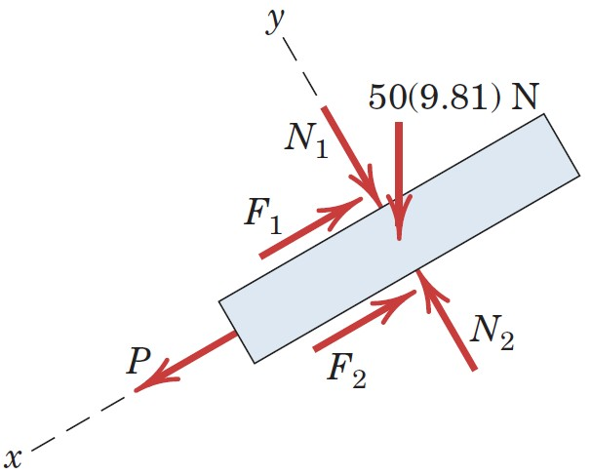
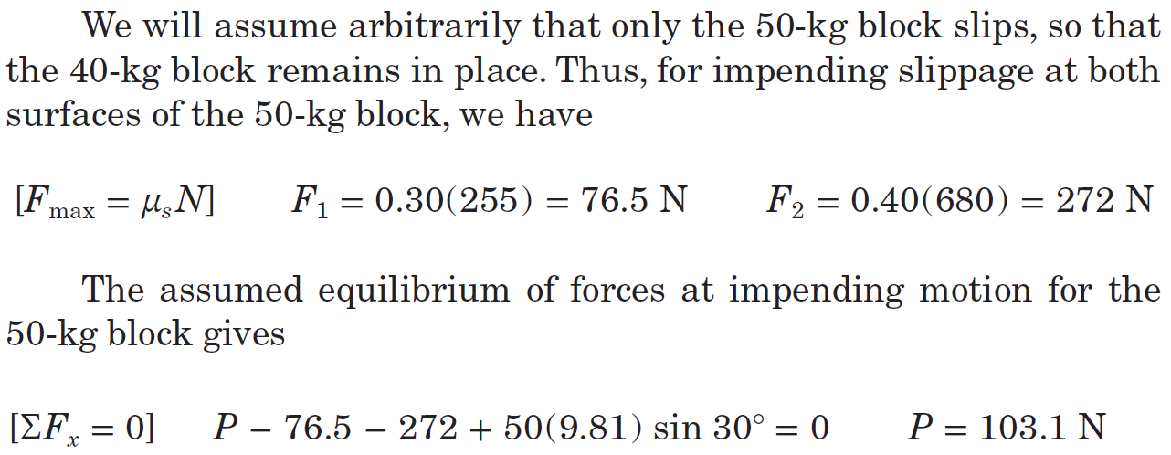
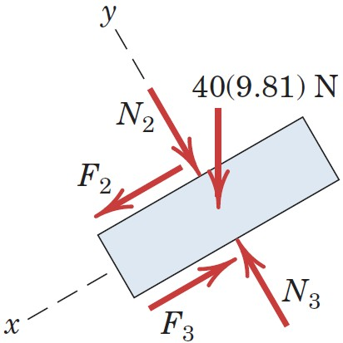
Article 6/3 – Sample Problem 6/5 (3 of 4)
Assume 50-kg Block Slips

Slide 26
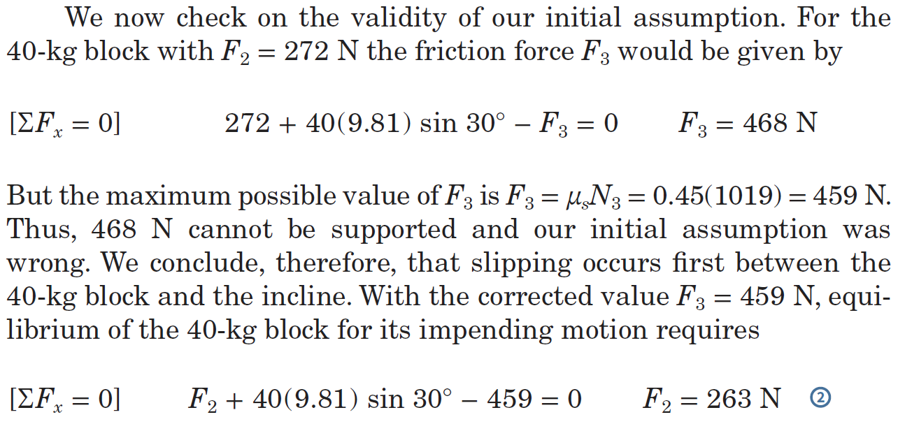
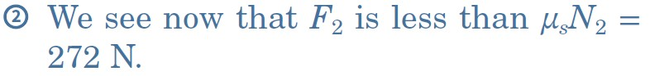
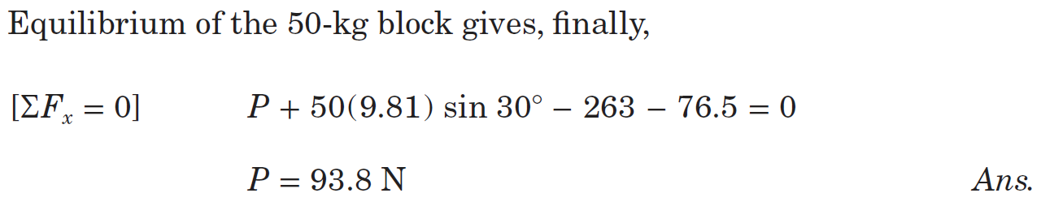
Article 6/3 – Sample Problem 6/5 (4 of 4)
Check Assumption
Revise Calculation for P

Slide 27
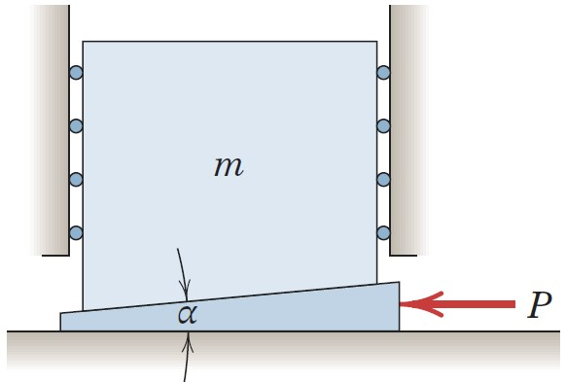
Article 6/4 Wedges
Overview and Illustration

Slide 28
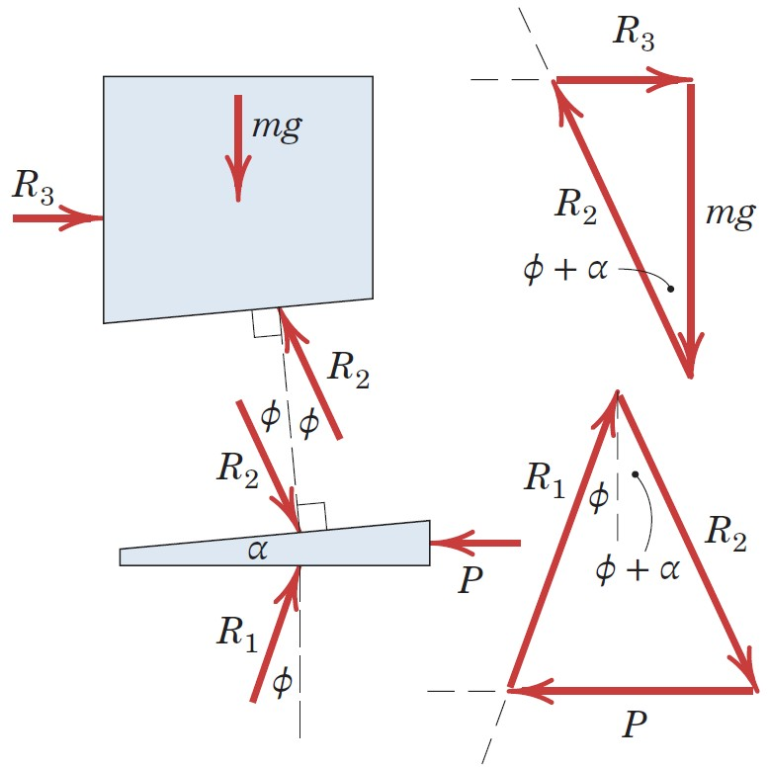
Article 6/4 – Raising a Load
Free-Body Diagrams
Wedge Angle, α
Force Polygons

Slide 29
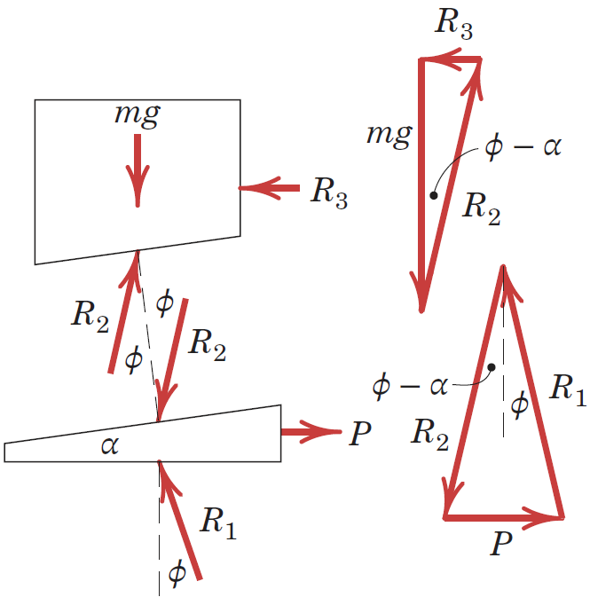
Article 6/4 – Lowering a Load
Free-Body Diagrams
Wedge Angle, α
Force Polygons

Slide 30
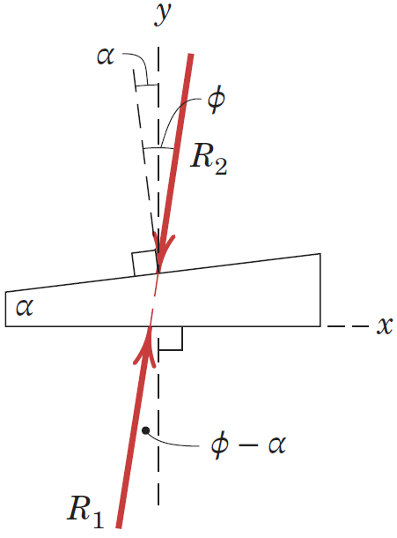
Article 6/4 – Self-Locking of a Wedge (1 of 2)
Explanation of Self-Locking
Impending Slip at the Upper Surface

Slide 31
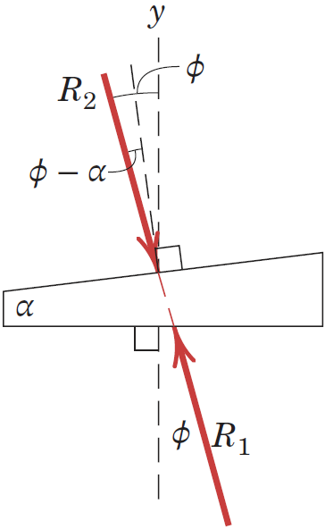
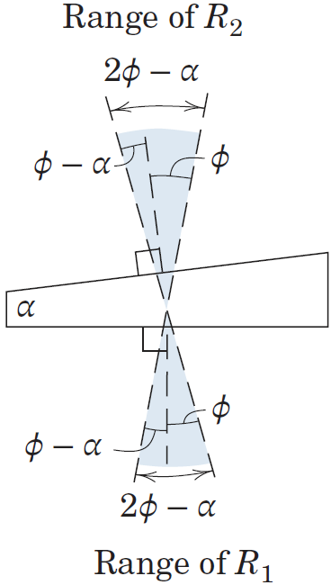
Article 6/4 – Self-Locking of a Wedge (2 of 2)
Impending Slip at the Lower Surface
Range for No Slip

Slide 32
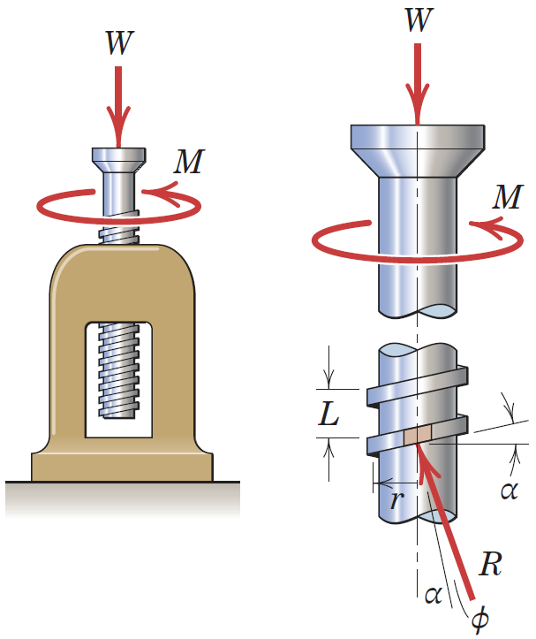
Article 6/5 Screws
Introduction
Force Analysis
Applied Moment, M = Wr tan (α + 𝜙)
Lead, L
Helix Angle, tan α = L/2πr

Slide 33
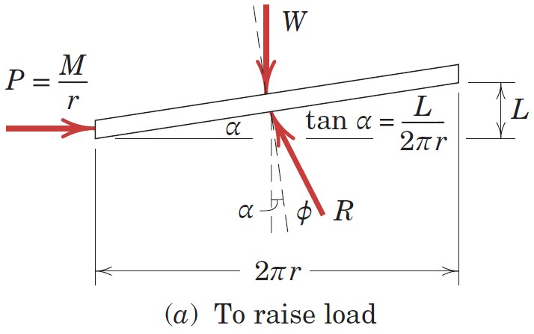
Article 6/5 – Unwrapped Thread View
Applied Moment, M = Wr tan (α + 𝜙)
Helix Angle, tan α = L/2πr
Equivalent Force, P = M/r

Slide 34
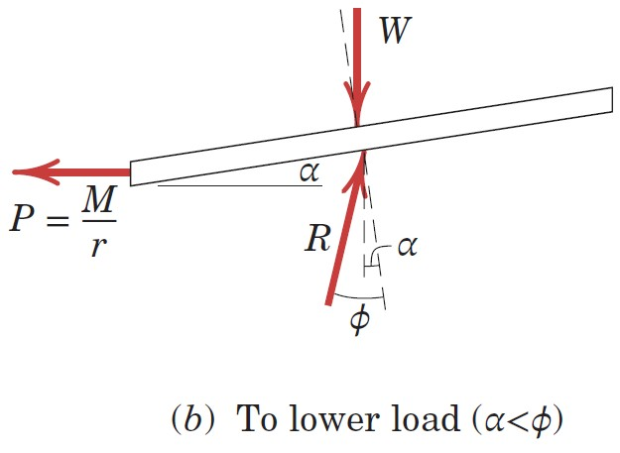
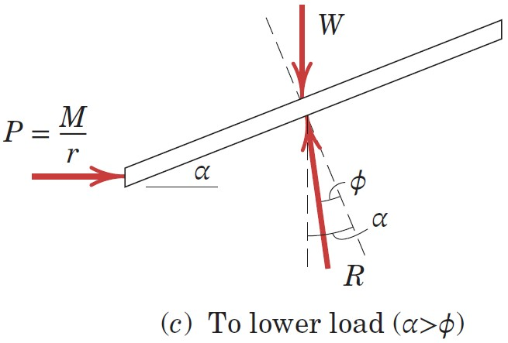
Article 6/5 – Conditions for Unwinding
Case I: α < 𝜙
Case II: α > 𝜙

Slide 35

Article 6/5 – Sample Problem 6/6 (1 of 4)
Problem Statement
The horizontal position of the 500-kg rectangular block of concrete is adjusted by the 5° wedge under the action of the force P. If the coefficient of static friction for both wedge surfaces is 0.30 and if the coefficient of static friction between the block and the horizontal surface is 0.60, determine the least force P required to move the block.

Slide 36



Article 6/5 – Sample Problem 6/6 (2 of 4)
Solution

Slide 37


Article 6/5 – Sample Problem 6/6 (3 of 4)
Algebraic Solution

Slide 38


Article 6/5 – Sample Problem 6/6 (4 of 4)
Graphical Solution

Slide 39

Article 6/5 – Sample Problem 6/7 (1 of 4)
Problem Statement
The single-threaded screw of the vise has a mean diameter of 1 in. and has 5 square threads per inch. The coefficient of static friction in the threads is 0.20. A 60-lb pull applied normal to the handle at A produces a clamping force of 1000 lb between the jaws of the vise. (a) Determine the frictional moment M_{B}, developed at B, due to the thrust of the screw against the body of the jaw. (b) Determine the force Q applied normal to the handle at A required to loosen the vise.

Slide 40



Article 6/5 – Sample Problem 6/7 (2 of 4)
Equilibrium of the Jaw

Slide 41


Article 6/5 – Sample Problem 6/7 (3 of 4)
(a) To Tighten

Slide 42


Article 6/5 – Sample Problem 6/7 (4 of 4)
(b) To Loosen

Slide 43

Article 6/6 Journal Bearings
Purpose
Illustration
Load Analysis
Torque to Maintain Rotation
M = Lr sin 𝜙 = μLr

Slide 44

Article 6/7 Thrust Bearings; Disk Friction
Purpose
Example
Westend61 GmbH/Alamy Stock Photo

Slide 45

Article 6/7 – Disk Friction Load Analysis
Free-Body Diagram
Axial Force, P
Transmitted Torque, M
Pressure Between the Plates, p = P/πR²
Friction Force on a Differential Area
dF = μp dA
Integration over the Disk Area
M = 2/3 μPR

Slide 46

Article 6/7 – Collar Bearing Load Analysis
Example with a Collar Bearing
Inside Contact Radius, R_{i}
Outside Contact Radius, R_{o}
Integration over the Disk Area
M = 2/3 μP(R_{o}³ - R_{i}³)/(R_{o}² - R_{i}²)

Slide 47
Article 6/7 – Effect of Wear-In
Solid Disks
M = 1/2 μPR
Ring Disks
M = 1/2 μP(R_{o} + R_{i})

Slide 48

Article 6/7 – Sample Problem 6/8 (1 of 4)
Problem Statement
The bell crank fits over a 100-mm-diameter shaft which is fixed and cannot rotate. The horizontal force T is applied to maintain equilibrium of the crank under the action of the vertical force P = 100 N. Determine the maximum and minimum values which T may have without causing the crank to rotate in either direction. The coefficient of static friction 𝜇 between the shaft and the bearing surface of the crank is 0.20.

Slide 49


Article 6/7 – Sample Problem 6/8 (2 of 4)
Solution

Slide 50

Article 6/7 – Sample Problem 6/8 (3 of 4)
Impending Counterclockwise Motion

Slide 51


Article 6/7 – Sample Problem 6/8 (4 of 4)
Impending Clockwise Motion

Slide 52
Article 6/8 Flexible Belts
Introduction
Illustration
© Media Bakery

Slide 53


Article 6/8 – Derivation (1 of 2)
Situation of Interest
Free-Body Diagram of a Belt Segment

Slide 54


Article 6/8 – Derivation (2 of 2)
Equilibrium Conditions
Combine and Integrate
dT/T = μ dθ → T₂ = T₁e^{μβ}

Slide 55
Article 6/8 – The Belt Friction Equation
Comments about the Equation: T₂ = T₁e^{μβ}
T₂ = the larger of the two belt tensions (it points in the direction the belt will tend to move in along the surface).
T₁ = the smaller of the two belt tensions (it opposes the motion of the belt along the surface).
μ = the coefficient of friction between the belt and the surface.
β = the total angle of belt contact with the surface. It must be expressed in radians.

Slide 56

Article 6/9 Rolling Resistance
Introduction
Illustration
Load Analysis
Load on the Wheel, L
Force to Maintain Speed, P
Distribution of Pressure over the Contact Area, p
Resultant Pressure-Force Distribution, R
Location of Resultant Pressure Force, A
Forward Shift of the Pressure Center from the Wheel Center, a

Slide 57
Article 6/9 – Load Analysis
Moment Sum about the Pressure Center
P = a/rL = μ_{r}L
Coefficient of Rolling Resistance, μ_{r}

Slide 58

Article 6/9 – Sample Problem 6/9 (1 of 3)
Problem Statement
A flexible cable which supports the 100-kg load is passed over a fixed circular drum and subjected to a force P to maintain equilibrium. The coefficient of static friction 𝜇 between the cable and the fixed drum is 0.30. (a) For 𝛼 = 0, determine the maximum and minimum values which P may have in order not to raise or lower the load. (b) For P = 500 N, determine the minimum value which the angle 𝛼 may have before the load begins to slip.

Slide 59



Article 6/9 – Sample Problem 6/9 (2 of 3)
Part (a) α = 0

Slide 60



Article 6/9 – Sample Problem 6/9 (3 of 3)
Part (b) P = 500 N

Slide 61

Article 6/9 – Sample Problem 6/10 (1 of 4)
Problem Statement
Determine the range of mass m over which the system is in static equilibrium. The coefficient of static friction between the cord and the upper curved surface is 0.20, while that between the block and the incline is 0.40. Neglect friction at the pivot O.

Slide 62


Article 6/9 – Sample Problem 6/10 (2 of 4)
Equilibrium of Slender Bar

Slide 63



Article 6/9 – Sample Problem 6/10 (3 of 4)
Case I: Motion Impends Up the Incline

Slide 64



Article 6/9 – Sample Problem 6/10 (4 of 4)
Case II: Motion Impends Down the Incline

